Slide 1
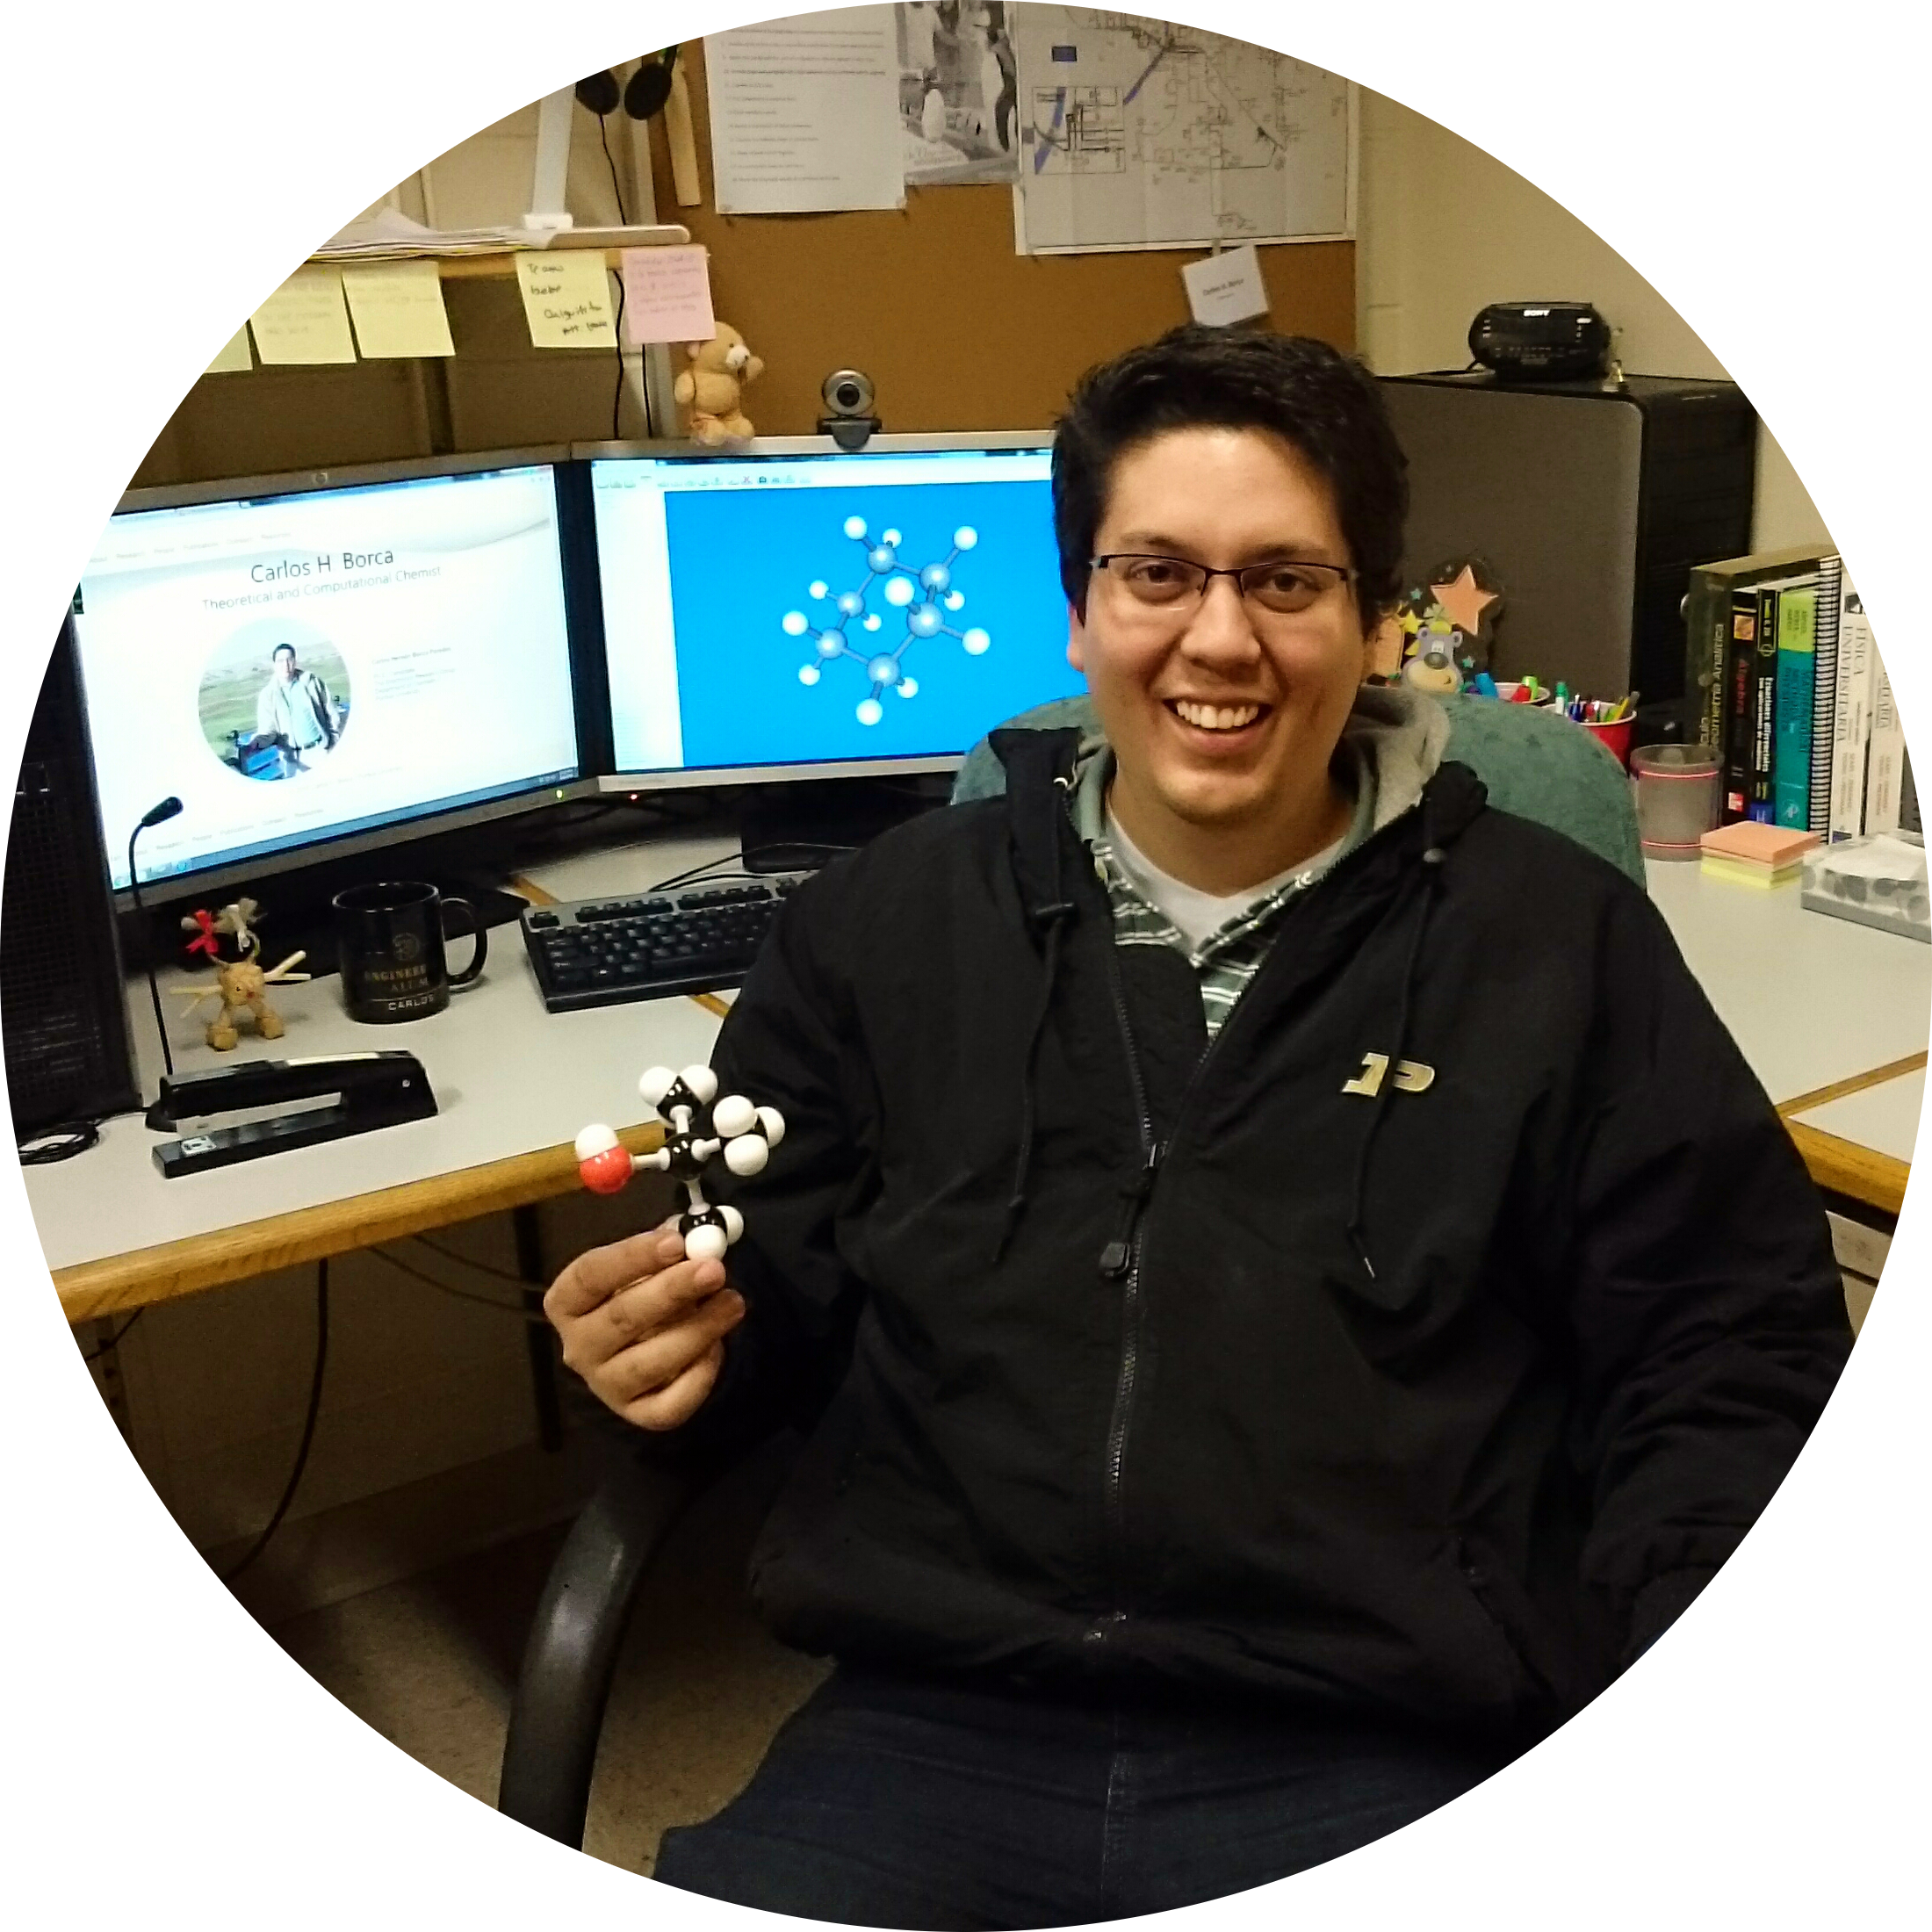
Carlos Hernán Borca Paredes
Ph.D. Candidate
The Slipchenko Research Group
Department of Chemistry
Purdue University
Research Interests:
Classical Molecular Dynamics
Fragmentation Methods
Excited-states Phenomena
Density Functional Development

